Slide 1
English
Unit 2 – Sport
WALT:
Plan a piece of writing using the first conditional and modal verbs.

Slide 2



WALT: Plan a piece of writing using the first conditional and modal verbs.
I can choose which project I want to complete.
I can identify the success criteria for the project.
I can think of some example sentences that fit my project and meet the SC.

Slide 3
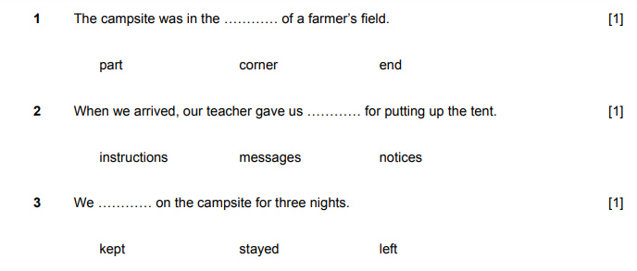
Retrieval Practice
WALT: Plan a piece of writing using the first conditional and modal verbs.

Slide 4
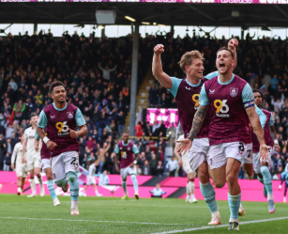
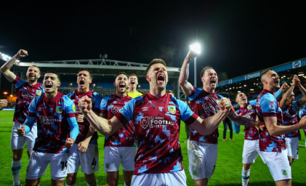
Starter – Answer the questions about football on the next slide with your partner.
WALT: Plan a piece of writing using the first conditional and modal verbs.

Slide 5
Warm Up
True or false?
Both teams should wear the same colour.
False
Players must wear shin guards.
True
World cup stadiums must be able to hold 40,000 people.
True
Players must leave the pitch if they receive a yellow card.
False

Slide 6
This lesson you are going to plan your project.
WALT: Plan a piece of writing using the first conditional and modal verbs.
Project A – create a poster about a type of sport.
Project B – make a commentary of a sports event.

Slide 7
WALT: Plan a piece of writing using the first conditional and modal verbs.
Project A – create a poster about a type of sport

Slide 8
WALT: Plan a piece of writing using the first conditional and modal verbs.
Project B – make a commentary of a sports event.

Slide 9
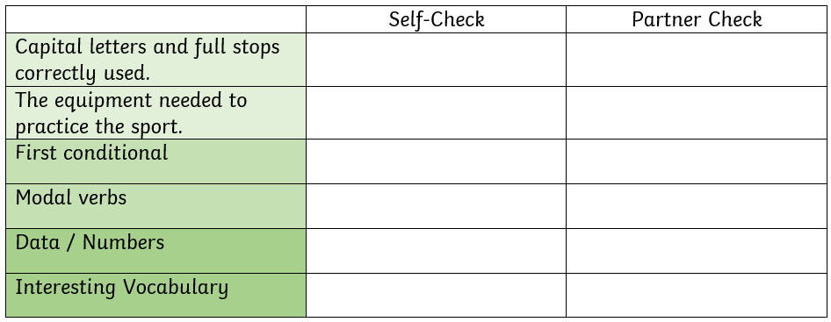
WALT: Plan a piece of writing using the first conditional and modal verbs.
These are the success criteria you need to meet in your project.

Slide 10
WALT: Plan a piece of writing using the first conditional and modal verbs.
Discuss with your partner the success criteria now. How could you meet them in your project?

Slide 11
WALT: Plan a piece of writing using the first conditional and modal verbs.
I can choose which project I want to complete.
I can identify the success criteria for the project.
I can think of some example sentences that fit my project and meet the SC.

Slide 12

Plenary – Show me out of 10
WALT: Plan a piece of writing using the first conditional and modal verbs.
How ready do you feel to complete the project next lesson?

